Slide 1


JAVA INTERVIEW BOOTCAMP ADVANCE CONCEPTS
Lecture 19
Advance Concepts In Exception Handling

Slide 2
CHAPTER 19
Advance Concepts
Topics Covered
The Error class
Java’s New Exception Handling Features

Slide 3
Errors
An error is a serious exception thrown by the JVM as a result of an error in the environment state that processes your code.
For example, NoClassDefFoundError
which is an error thrown by the JVM when it’s unable to locate the .class file that it’s supposed to run.
Another error is StackOverflowError
which occurs when the size of the memory required by the stack of a Java program is greater than what the JRE has offered for the Java application, for example an infinite recursive code.

Slide 4
Errors
An error is a subclass of class java.lang.Error.
An error need not be a part of a method signature.
An error can be caught by an exception handler, but it shouldn’t be.

Slide 5
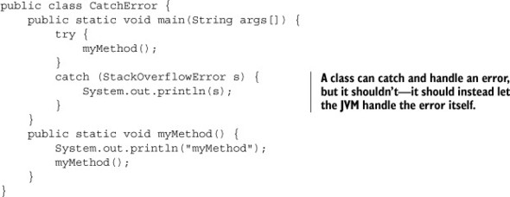
Write A Code that handles StackOverFlowError

Slide 6
Common Exceptions and Errors
Exception | Error
ArrayIndexOutOfBoundsException | ExceptionInInitializerError
IndexOutOfBoundsException | StackOverflowError
ClassCastException | NoClassDefFoundError
IllegalArgumentException | OutOfMemoryError
IllegalStateException
NullPointerException
NumberFormatException

Slide 7
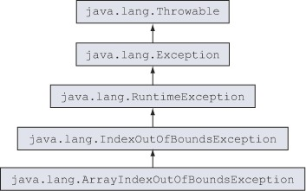
ArrayIndexOutOfBoundsException and IndexOutOfBoundsException

Slide 8
ArrayIndexOutOfBoundsException and IndexOutOfBoundsException
ArrayIndexOutOfBoundsException is thrown when a piece of code tries to access an array out of its bounds (either an array is accessed at a position less than 0 or at a position greater than or equal to its length).
IndexOutOfBoundsException is thrown when a piece of code tries to access a list, like an ArrayList, using an illegal index.

Slide 9
ArrayIndexOutOfBoundsException and IndexOutOfBoundsException
Assuming that an array and list have been defined as
follows:
String[] season = {"Spring", "Summer"};
ArrayList<String> exams = new ArrayList<>();
exams.add(“Java");
exams.add(“Oracle");

Slide 10
ArrayIndexOutOfBoundsException and IndexOutOfBoundsException
The following lines of code will
throw ArrayIndexOutOfBoundsException:

Slide 11
ArrayIndexOutOfBoundsException and IndexOutOfBoundsException
And the following lines of code will
throw IndexOutOfBoundsException:

Slide 12
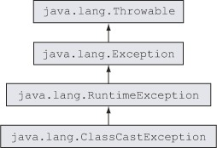
ClassCastException

Slide 13
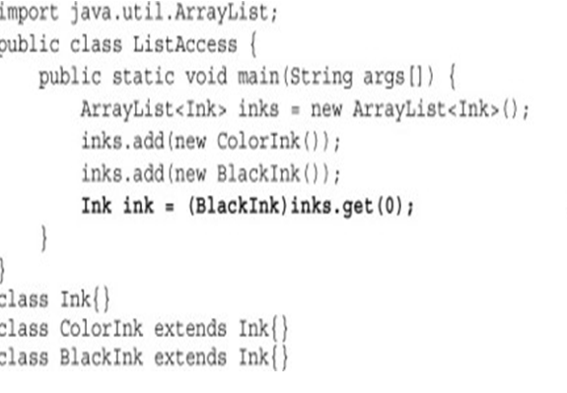
ClassCastException
ClassCastException is thrown when an object fails an IS-A test with the class type to which it’s being cast
Output:
ClassCastException

Slide 14
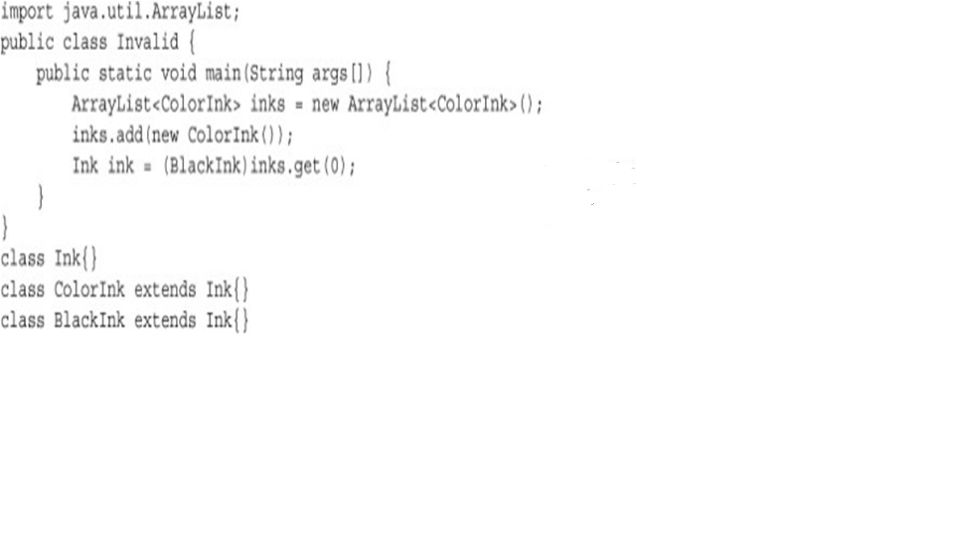
ClassCastException
What will happen now ?
Compilation Error:
Incompatible Types

Slide 15
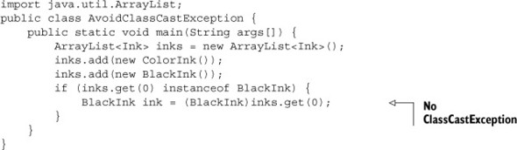
ClassCastException
How to avoid this ?
We can use the instanceof operator to verify whether an object can be cast to another class before casting it

Slide 16
What Is The Output ?
class Ink{}
interface Printable {}
class ColorInk extends Ink implements Printable {}
class BlackInk extends Ink{}
class TwistInTaleCasting {
public static void main(String args[]) {
Printable printable = null;
BlackInk blackInk = new BlackInk();
printable = (Printable)blackInk;
}
}
A. printable = (Printable)blackInk will throw compilation error.
B. printable = (Printable)blackInk will throw runtime exception.
C. printable = (Printable)blackInk will throw checked exception.
D. The following line of code will fail to compile:
printable = blackInk;
Answer:
printable = (Printable)blackInk will throw runtime exception.

Slide 17
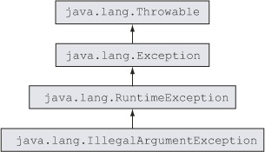
IllegalArgumentException

Slide 18
IllegalArgumentException
As the name of this exception suggests, IllegalArgumentException is thrown to specify that a method has passed illegal or inappropriate arguments.
For example:
Thread th=new Thread();
th.setPriority(11);
The statement will throw IllegalArgumentException because value passed to setPriority( ) method cannot be more than 10

Slide 19
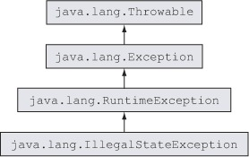
IllegalStateException

Slide 20
IllegalStateException
An IllegalStateException signals that a method has been invoked at an illegal or inappropriate time.
In other words, the Java environment or Java application is not in an appropriate state for the requested operation

Slide 21
IllegalStateException
For example:
Iterator it = vect1.iterator();
while(it.hasNext())
{
it.remove();
}
The above code works fine. But calling it.remove()
without calling it.next() is an IllegalStateException.

Slide 22
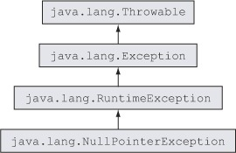
NullPointerException

Slide 23
NullPointerException
This exception is thrown by the JVM if you try to access a method or a variable with a null value.
The only way to avoid this exception is to ensure that the reference variable has been assigned a non-null value

Slide 24
Causes Of NullPointerException
Accessing members of a reference variable that is assigned a null value.
Accessing members of an uninitialized instance or static reference variable. These are implicitly assigned a null value.
Attempting to access positions of a nonexistent array.
Using members of an array element that are assigned a null value.

Slide 25
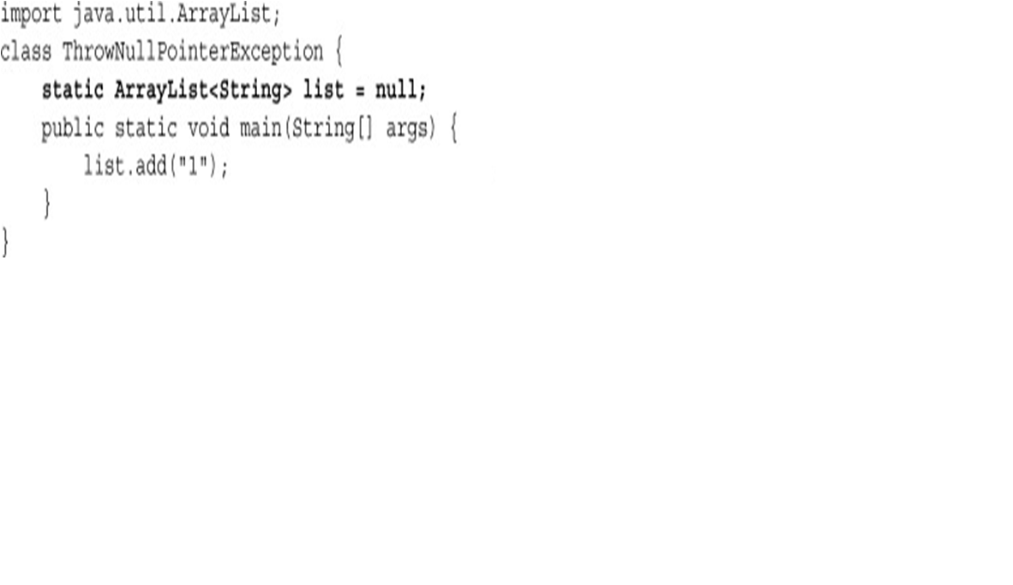
NullPointerException Example
The code below tries to access the method add on variable list, which has been assigned a null value. So it throws a “NullPointerException”
Will throw NullPointerException

Slide 26
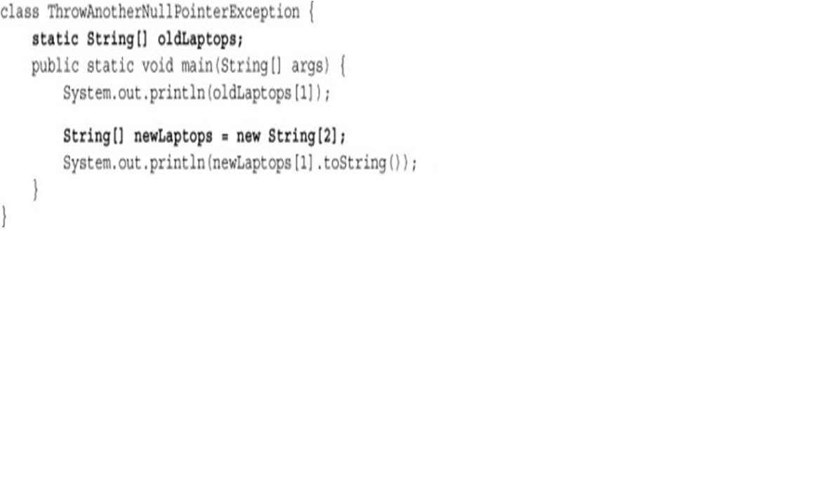
NullPointerException Example
Another set of conditions when code may throw the NullPointerException involves use of arrays:
Will throw NullPointerException
Will throw NullPointerException

Slide 27
What will happen if we remove toString( ) from last SOP ?
String [ ] newLapotops=new String[2];
System.out.println(newLaptops[1]);
it won’t throw an exception—
it’ll print the value null

Slide 28
What Is The Output ?
class Demo{
public static void main(String[] args) {
String[ ][ ] oldLaptops = { {"Dell", "Toshiba", "Vaio"}, null, {"IBM"}, new String[10] }; System.out.println(oldLaptops[0][0]); // line 1 System.out.println(oldLaptops[1]); // line 2 System.out.println(oldLaptops[3][6]); // line 3 System.out.println(oldLaptops[3][0].length()); // line 4 System.out.println(oldLaptops); // line 5
}
}
Code on line 1 will throw NullPointerException
Code on lines 1 and 3 will throw NullPointerException
Only code on line 4 will throw NullPointerException
Code on lines 3 and 5 will throw NullPointerException
Answer:
Only code on line 4 will throw NullPointerException

Slide 29
What Has Java 14 Improved In This ?
Java 14 enhances NullPointerException by showing precisely which variable was null.
Prior to Java 14 NPE messages did not contain the variable nor the method call that occurs the exception.
This behaviour has been corrected, although it needs some small customizations.

Slide 30
What Has Java 14 Improved In This ?
This feature can be enabled with the new boolean command-line option: -XX:+ShowCodeDetailsInExceptionMessages

